Slide 1
Introduction to Data Science
Section 3 – Least squares/linear regression

Slide 2
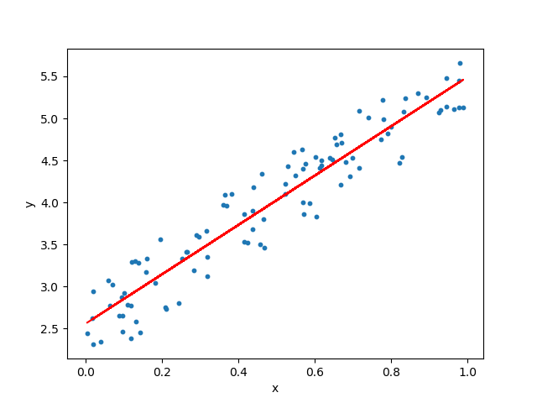
Linear Regression
https://towardsdatascience.com/linear-regression-using-python-b136c91bf0a2

Slide 3
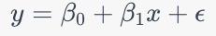
Problem setup
Aim: find the best-fitting line (or hyperplane in higher dimensions) through the data points. The equation for this line in the simple linear regression case (one feature) is given by:
y is the dependent variable (what we are trying to predict)
x is the independent variable (the input)
β₀​ and β₁​ are the parameters we are trying to learn
ϵ is the error term

Slide 4
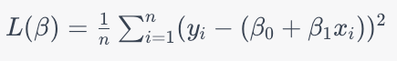
Finding β0 and β1: loss function
We get optimal β₀ and β₁ by minimizing mean squared error (MSE)
MSE is thus the "loss function"
treat β as a vector (β0, β1)

Slide 5
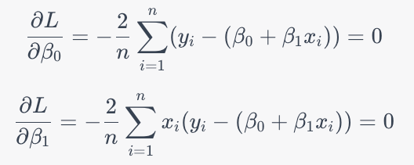
Finding β0 and β1: derivatives
To minimize the loss function, we take the partial derivatives of L(β) with respect to each parameter.
Set equations to zero, and solve.

Slide 6
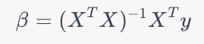
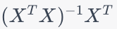
Finding β0 and β1: final solution
Magically, the optimal β has a nice matrix expression:
β is the vector of parameters (β₀ and β₁​)
X is the matrix of feature values (TRAINING data, with a column of ones added to represent the intercept term)
y is the vector of target values (TRAINING data)
The term is known as the pseudoinverse of the matrix X

Slide 7
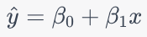
Making Predictions on TEST data
Optimal β:
Predictions on TEST data x using the equation:

Slide 8
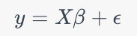
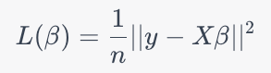
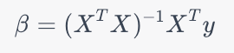
In higher dimensions
The linear regression model can be represented as:
y is the n×1 vector of target values
X is the n×d matrix of feature values
β is the d×1 vector of parameters
ϵ is the n×1 vector of error terms
Loss function:
Solution to the optimization problem:

